Slide 1

Office of Research and Sponsored Programs
Open Ideas Exchange
Just in Time (JIT) and Current and Pending Support
January 10, 2024

Slide 2
Agenda
What is JIT?
Overview of the NIH Just In Time process and other support information
ORSP JIT procedures and process
Current and Pending Support report through Kuali
Questions and Other Items

Slide 3
What IS Just in Time (JIT)?
A process used to gain additional information when an application is being considered for an award. This is NOT a notice of award.
Information submitted includes other support for senior/key personnel, IRB approval, IACUC approval, and evidence of compliance with protection of human research participants.
Notification through email.
Electronic submission through eRA Commons by ORSP.

Slide 4
Overview of the NIH JIT PRocess
Applications that fall within a certain percentile or priority score receive an email for a JIT request. A contact from an awarding agency may request this information as well.
System Email is sent to the PI (contact PI for multi-PI), the Sponsored Programs Administrator that facilitated the application, and the institutional AOR (Executive Director, ORSP).
An “other support” document is required to be submitted for all senior/key personnel along with the approvals for IRB and IACUC.
The submission of this information is expected no later than 60 days before the expected project start date.
As part of the submission, an electronic signature is required for each senior/key person submitting an “other support” document.

Slide 5
ORSP JIT Process and procedures
Email is received and the Sponsored Programs Administrator will reach out to the PI.
The PI, when ready to begin the process, will communicate and work collaboratively with the Sponsored Programs Administrator.
The Sponsored Programs Administrator pulls the proposal file and verifies senior/key personnel on the grant and any sub-award collaborators. If a sub-award, the SPA will reach out to the sub for their information.
The PI and each senior/key personnel will complete the other support document to the best of their knowledge and information. The SPA will verify this information.
Once the information has been completed and finalized and IACUC/IRB information confirmed (if applicable), the SPA will compile the other support documents into a single file and submit.

Slide 6
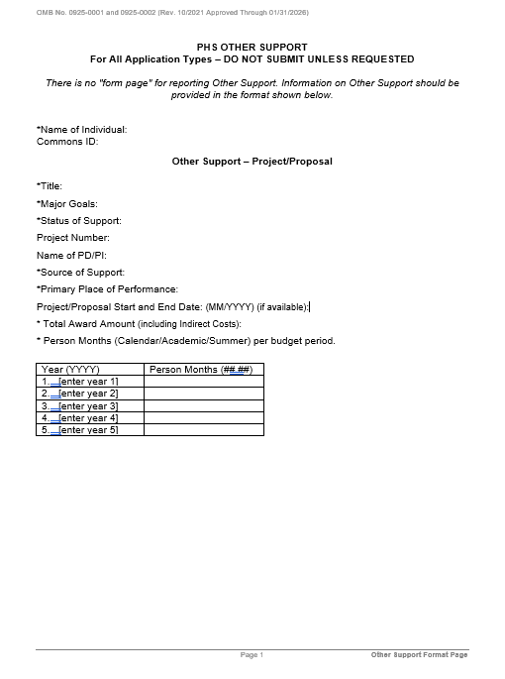
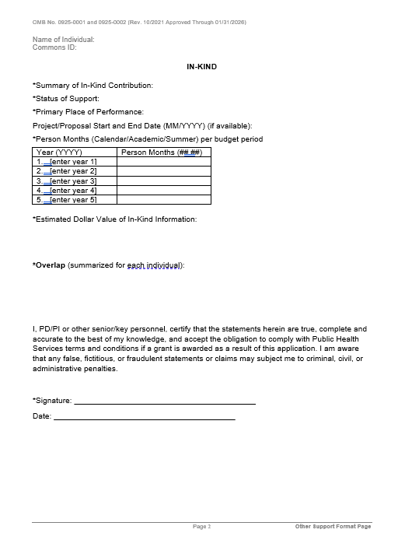
Other Support Template

Slide 7
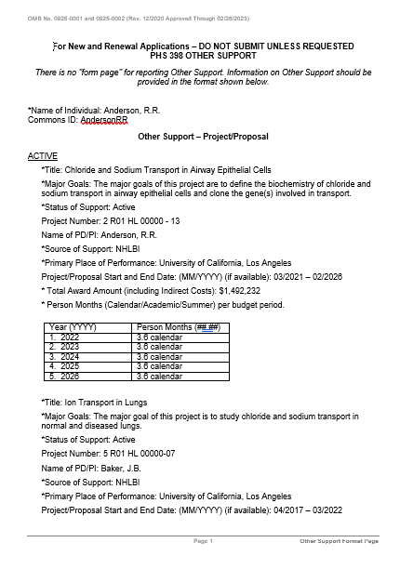
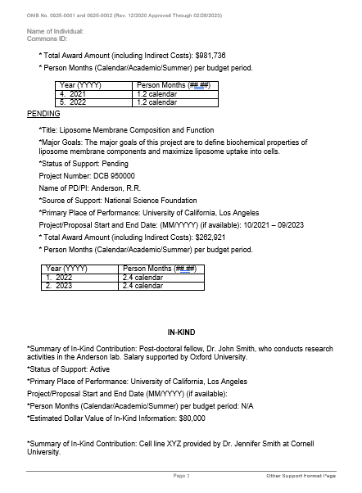
Other Support Sample,
https://grants.nih.gov/grants/forms/other-support-format

Slide 8
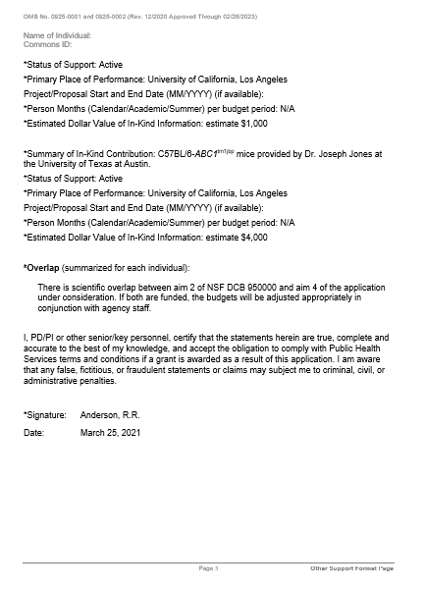
Other Support Sample,
https://grants.nih.gov/grants/forms/other-support-format

Slide 9
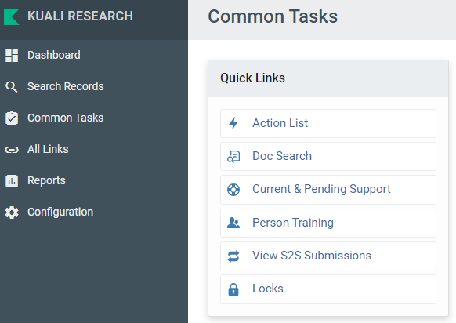

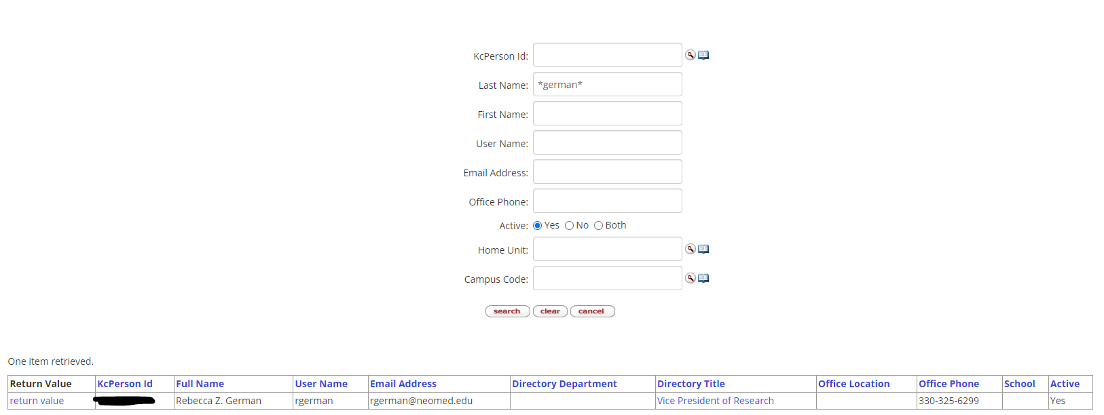
Current and Pending Support

Slide 10
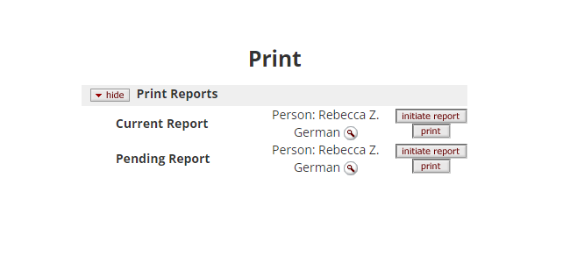
Current and Pending Support

Slide 11
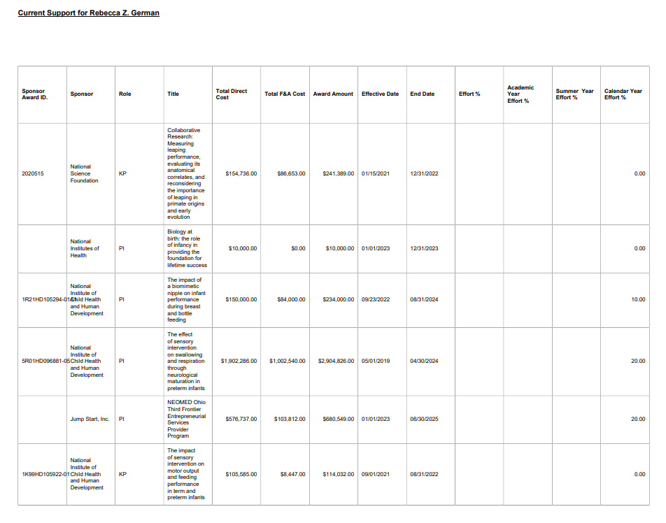
Current Support

Slide 12
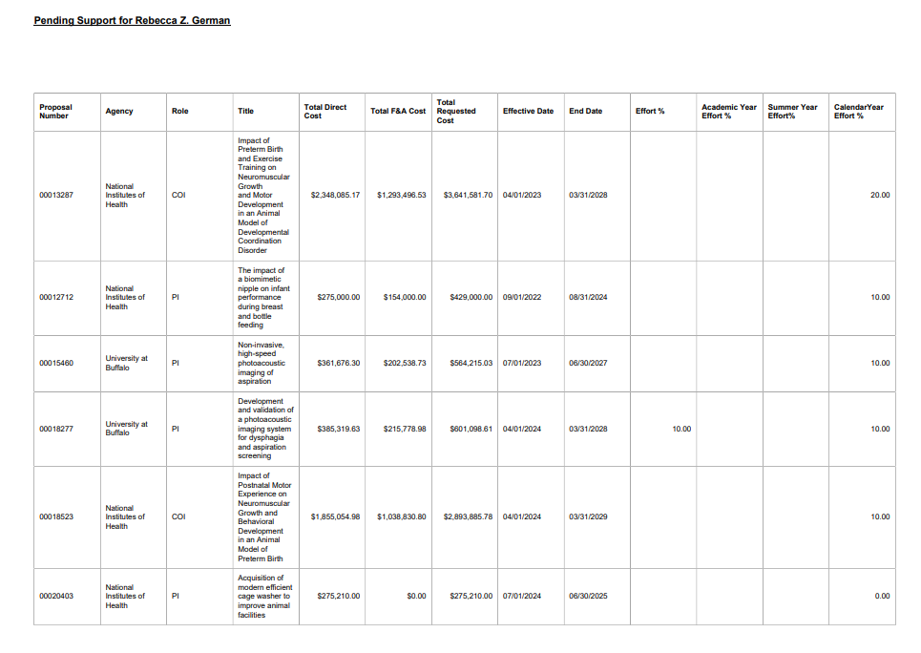
Pending Support

Slide 13


Slide 14
The Office of Research and Sponsored Programs is here to assist you in the pursuit of your research and other institutional funding.
Rebecca Hayes, Executive Director,
rlhayes@neomed.edu
Angelina Steiner, Director and eRA Manager, asteiner1@neomed.edu
General Questions or Assistance,
sponsored-programs@neomed.edu

